Slide 1
Reacting to Changes

Slide 3
Module Overview
Watching
Reacting
Reactive Transformations

Slide 5
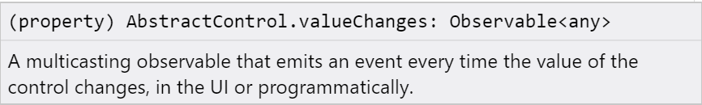
Watching
const phoneControl = this.customerForm.get('phone');
phoneControl.valueChanges.subscribe();
const phoneControl = this.customerForm.get('phone');
phoneControl.valueChanges
const phoneControl = this.customerForm.get('phone');
phoneControl.statusChanges.subscribe();

Slide 6
Watching
this.myFormControl.valueChanges.subscribe(value => console.log(value));
this.myFormGroup.valueChanges.subscribe(value => console.log(JSON.stringify(value)));
this.customerForm.valueChanges.subscribe(value => console.log(JSON.stringify(value)));

Slide 7
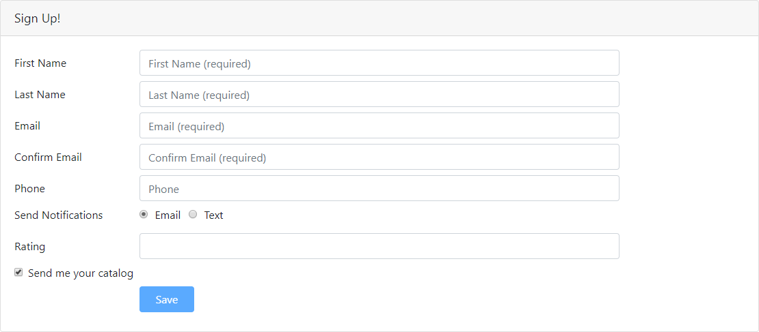
Watching

Slide 8





Reacting
Adjust validation rules
Handle validation messages
Modify user interface elements
Provide automatic suggestions
...

Slide 9

Demo
Displaying Validation Messages

Slide 10
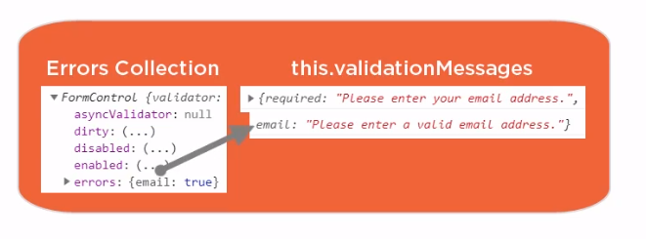

Slide 11
Reactive Transformations
debounceTime
Ignores events until a specific time has passed without another event
debounceTime(1000) waits for 1000 milliseconds (1 sec) of no events before emitting another event
a b @ c
a b @ c
a b @
a b
a
Err Err Err

Slide 12
Reactive Transformations
debounceTime
Ignores events until a specific time has passed without another event
debounceTime(1000) waits for 1000 milliseconds (1 sec) of no events before emitting another event
a
b @ c
d e
1000 ms
1000 ms
a
b @ c
d e
a b @ c

Slide 13
Reactive Transformations
throttleTime
Emits a value, then ignores subsequent values for a specific amount of time
distinctUntilChanged
Suppresses duplicate consecutive items

Slide 14
Checklist: Watching
Use the valueChanges Observable property
Subscribe to the Observable
this.myFormControl.valueChanges.subscribe( value => console.log(value)
);

Slide 15
Checklist: Reacting
this.myFormControl.valueChanges.subscribe( value => this.setNotification(value)
);
Change validation rules
Handle validation messages Adjust user-interface elements Provide automatic suggestions And more

Slide 16
Checklist: Reactive Transformations
import the operator
import { debounceTime } from 'rxjs/operators';
Use the operator
this.myFormControl.valueChanges.pipe( debounceTime(1000)
).subscribe(
value => console.log(value)
);

Slide 17
Summary
Watching
Reacting
Reactive Transformations

Slide 18
<div class="form-group">
<label class="col-md-2 col-form-label" for="emailId">Email</label>
<div class="col-md-8">
<input class="form-control" id="emailId" type="email" placeholder="Email (required)" required
email [(ngModel)]="customer.email" name="email" #emailVar="ngModel" [ngClass]="{'is-invalid':
(emailVar.touched || emailVar.dirty) &&
!emailVar.valid }" />
<span class="invalid-feedback">
<span *ngIf="emailVar.errors?.required"> Please enter your email address.
</span>
<span *ngIf="emailVar.errors?.email"> Please enter a valid email address.
<div class="form-group">
<label class="col-md-2 col-form-label" for="emailId">Email</label>
<div class="col-md-8">
<input class="form-control" id="emailId" type="email" placeholder="Email (required)" formControlName = "email" [ngClass]="{'is-invalid':
emailMessage}" />
<span class="invalid-feedback">
{{ emailMessage }}
</span>
</div>
</div>
</span>
</span>
</div>
</div>
Template-driven
Reactive

